Slide 1
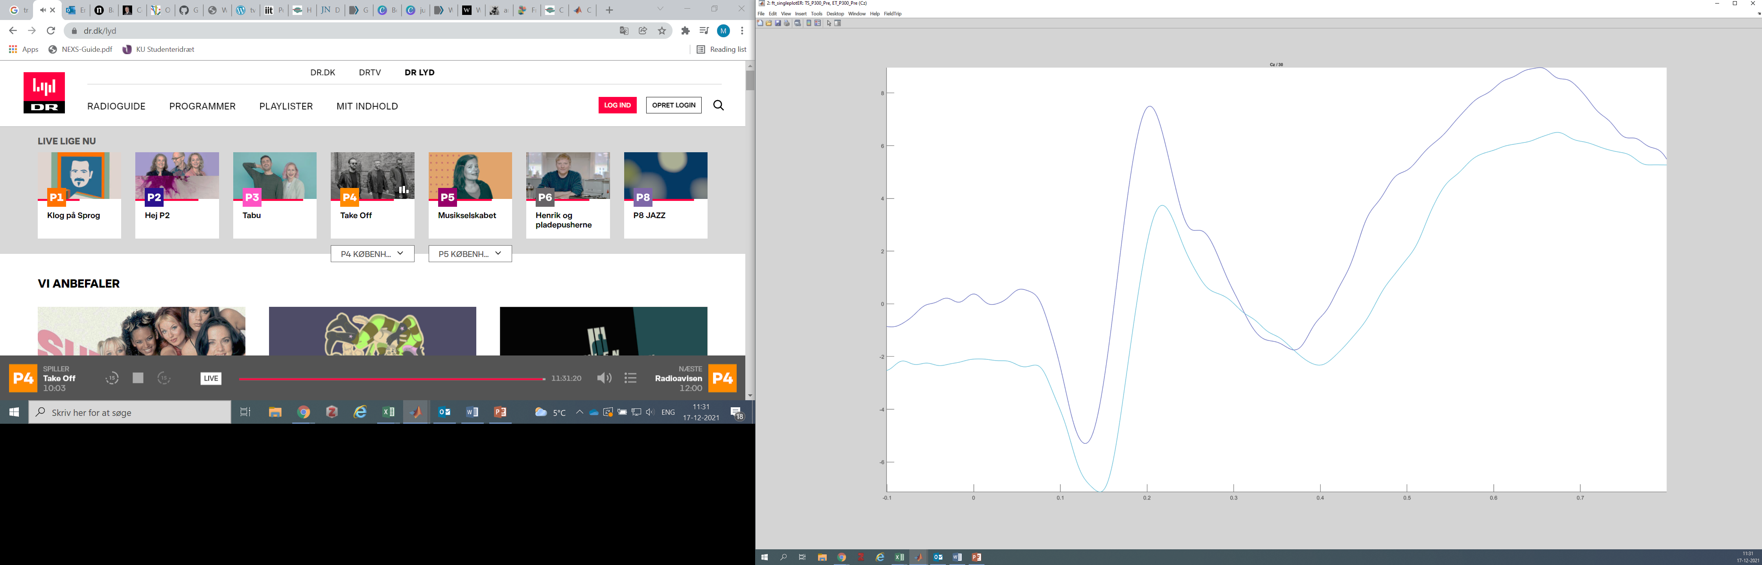
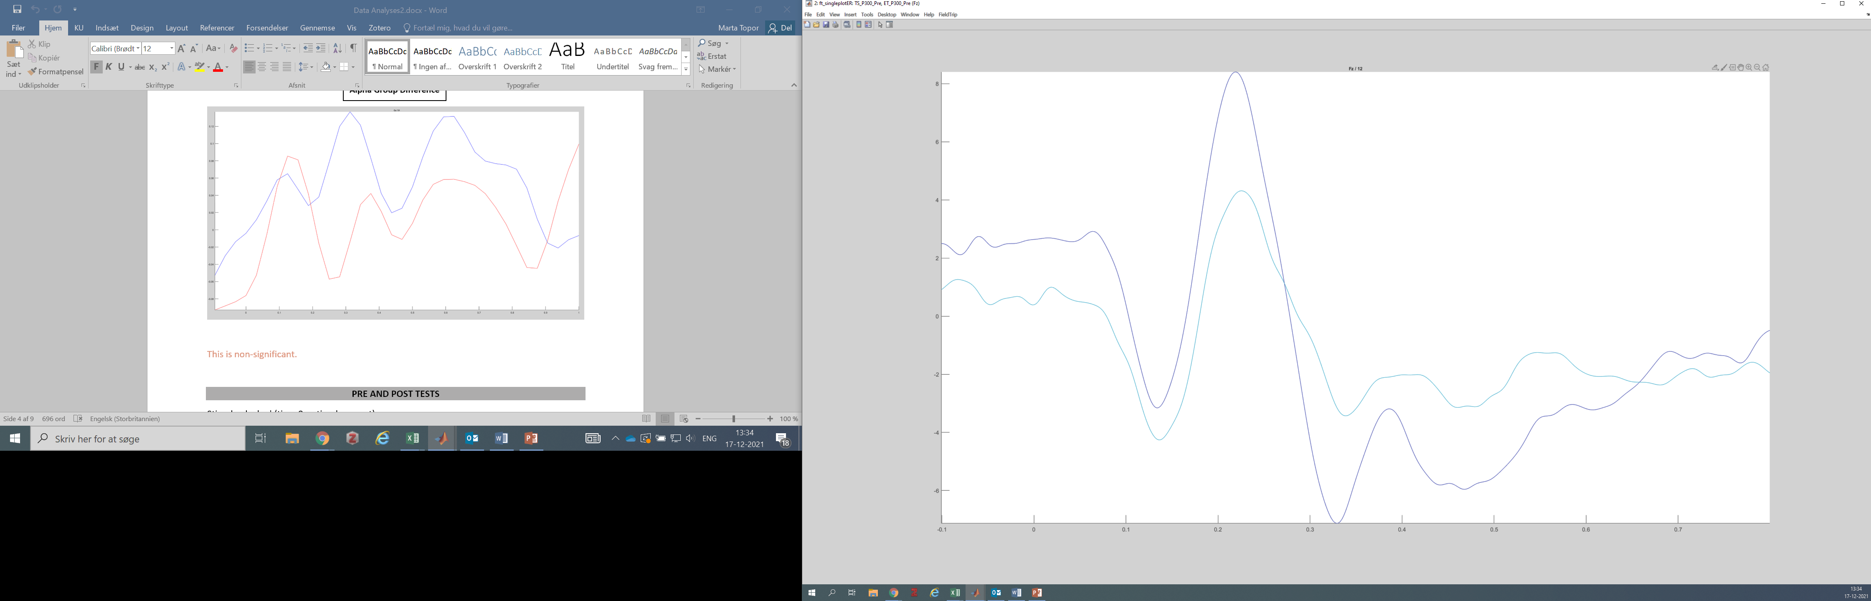
P300 baseline (T0) by intervention
18 Participants, Outliers removed, Divided by Intervention Group
Cz
Fz P300 at 150-300ms is non-significant at p=.053
P300 at 150-300ms is significant at p<.001
Fz
Touch Screen
Eye Tracker
P300 during the intervention will be compared between the groups on the Fz

Slide 2
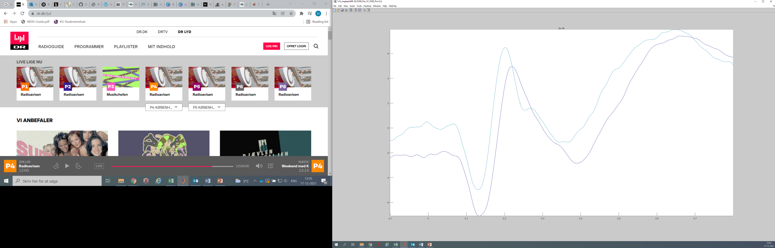
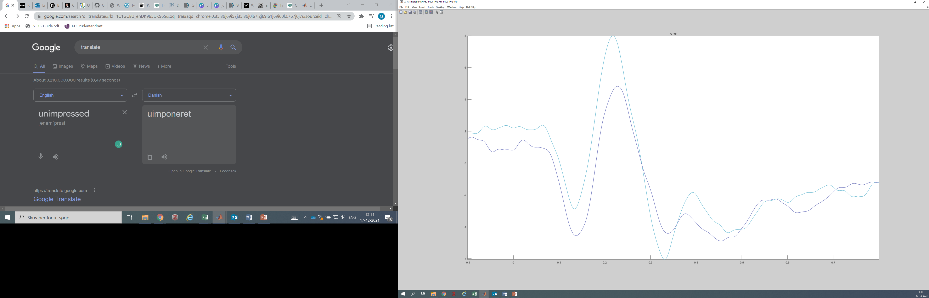
P300 baseline by age
18 Participants, Outliers removed, Divided by Intervention Group
Cz
Cz P300 at 150-300ms is significant at p=.021
Fz P300 at 150-300ms is inconclusive at p=.031
Fz
18 Participants, Outliers removed, Divided by Age (9 in each group)
Grade 1
Grade 0

Slide 3
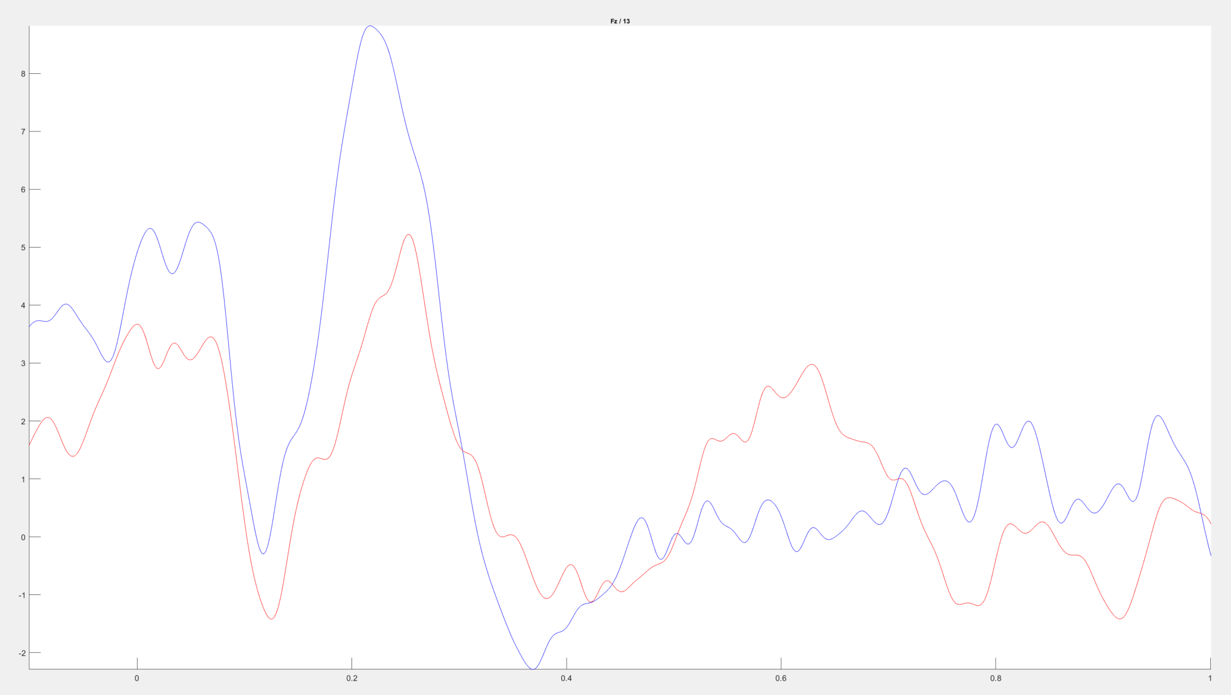
P300 Intervention
18 Participants, Outliers removed, Divided by Age (9 in each group)
Touch Screen
Eye Tracker
Fz P300 at 150ms-300ms during Intervention Significant p=.003

Slide 4
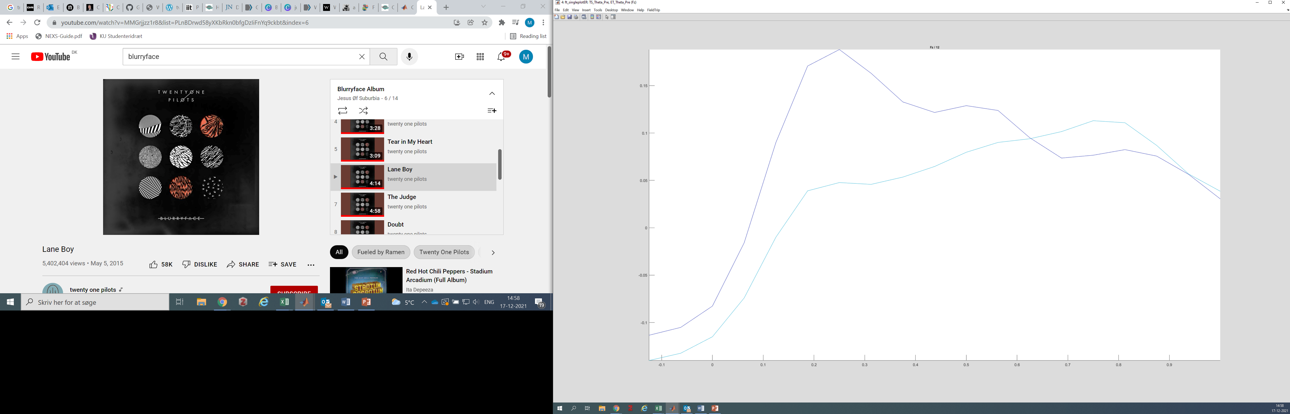
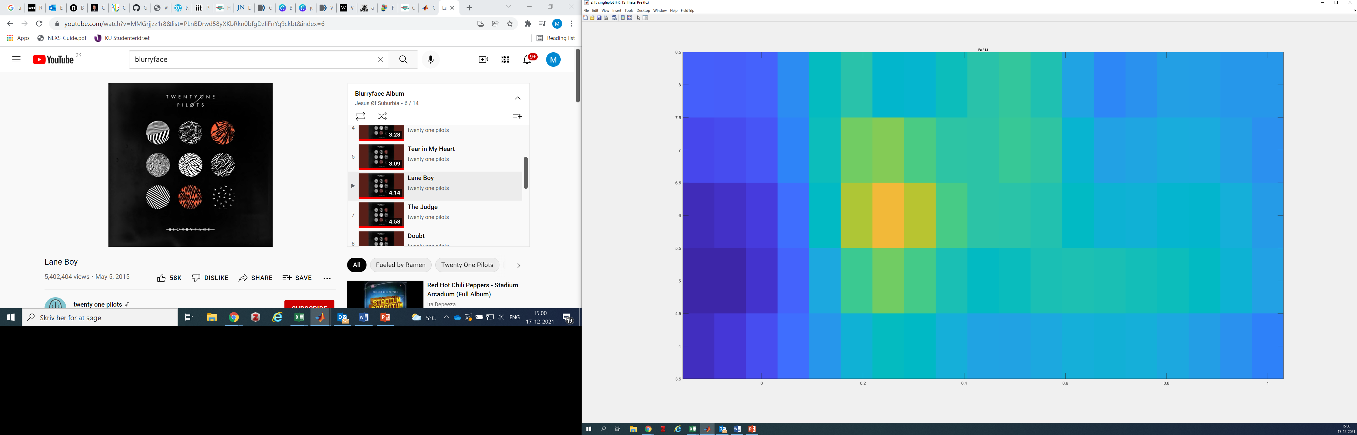
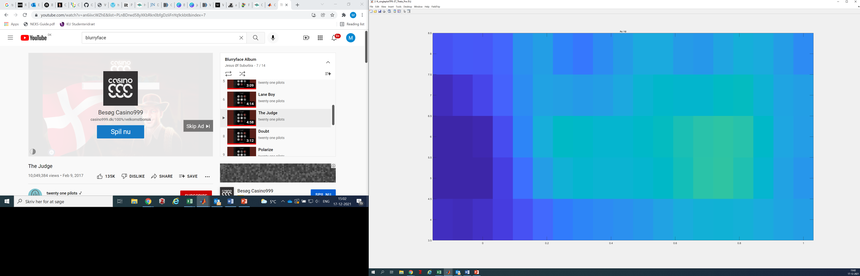
Theta baseline (T0) by intervention
Fz
Touch Screen
Fz Theta at 0-600ms is non-significant at p=.162
Touch Screen
Eye Tracker
18 Participants, Outliers removed, Divided by Intervention Group
Eye Tracker

Slide 5
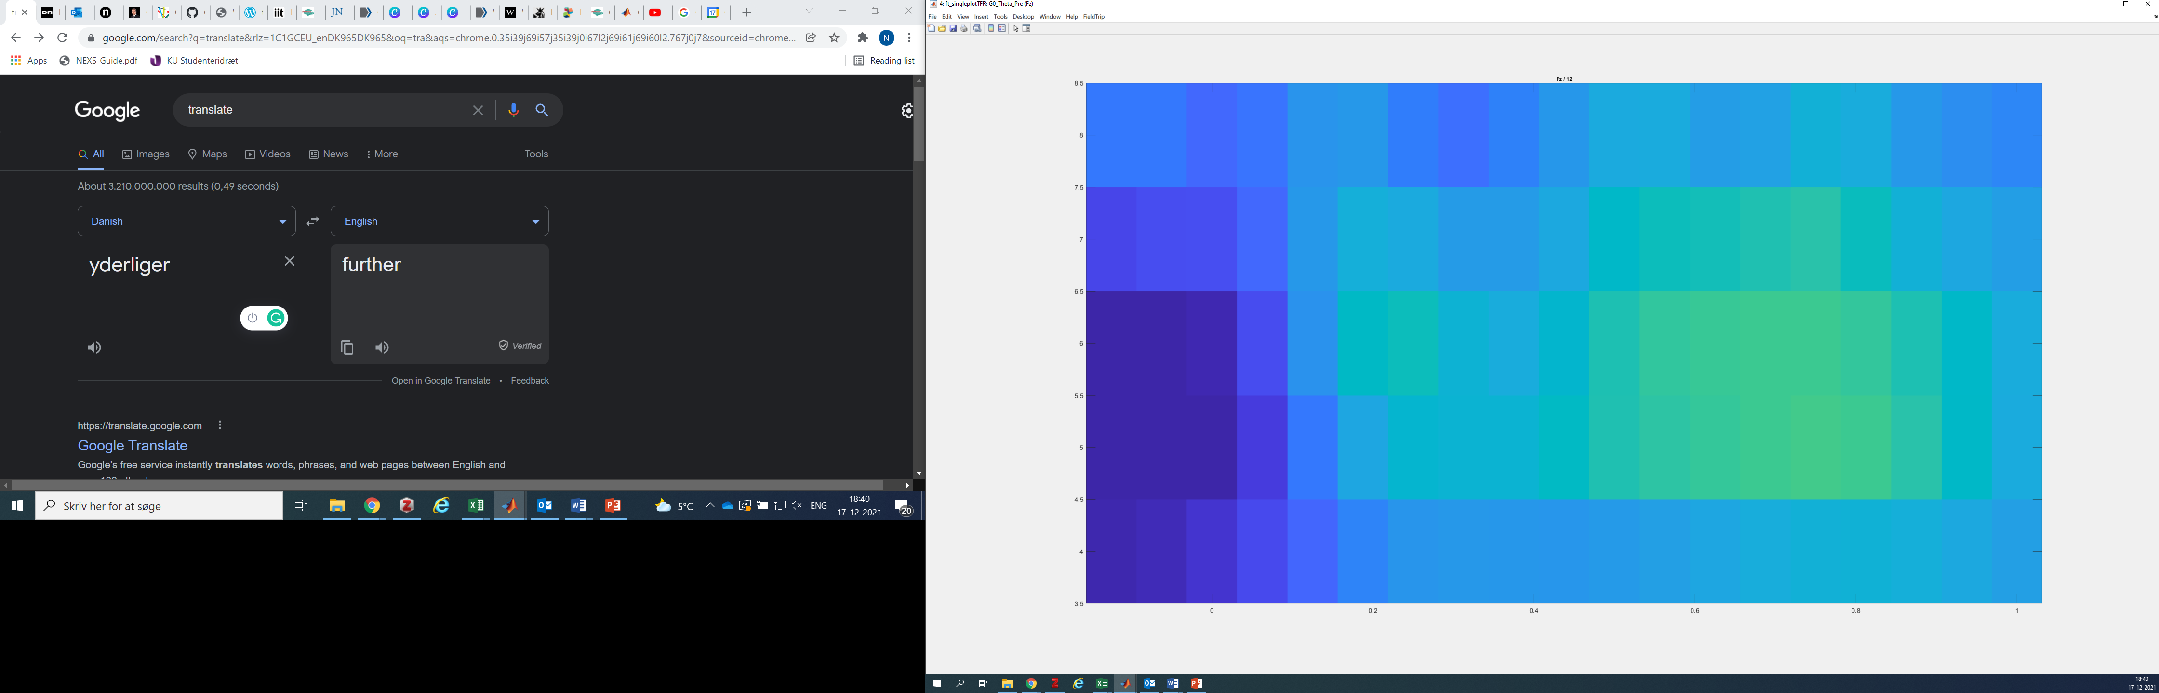
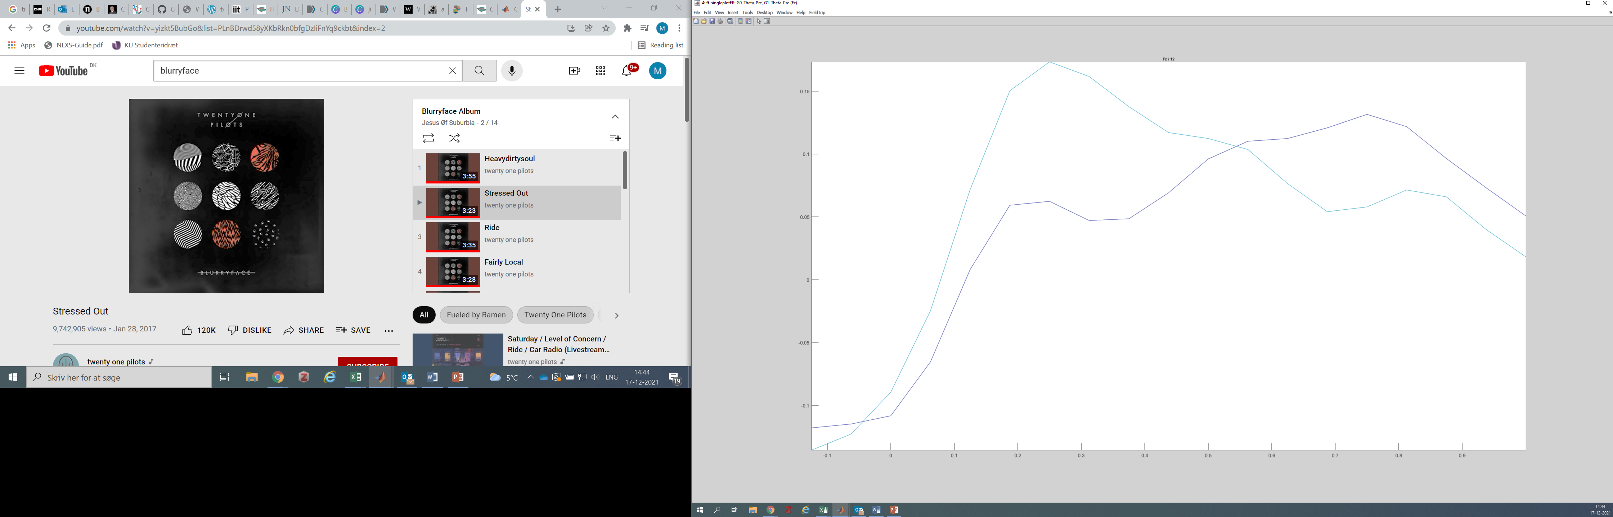
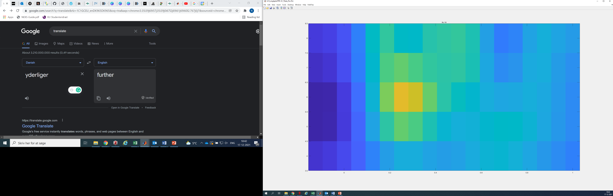
Theta baseline (T0) by age
Fz
Grade 0
Fz Theta at 0-600ms is non-significant at p=.121
Grade 1
Grade 1
Grade 0
18 Participants, Outliers removed, Divided by Age (9 in each group)

Slide 6
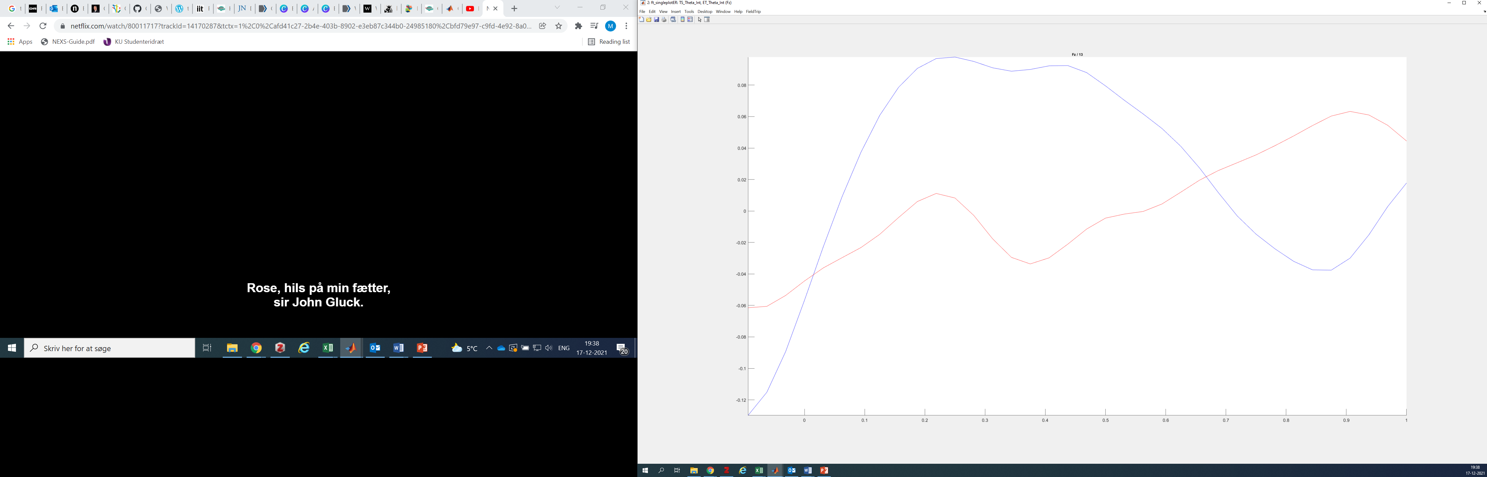

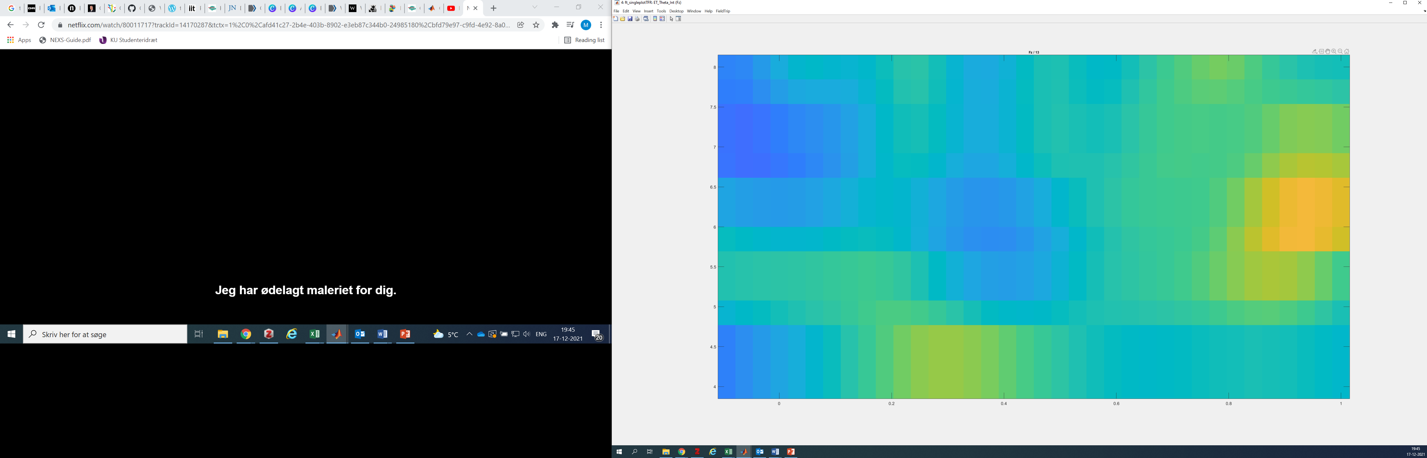
Theta Intervention
Fz
Touch Screen
Fz Theta at 0ms-600ms during Intervention non-significant p=.057
Eye Tracker
18 Participants, Outliers removed, Divided by Age (9 in each group)
Touch Screen
Eye Tracker
Notes:
Alpha and theta changes during arithmetic learning, increase in theta power for a more automatic and consolidated skill https://doi.org/10.1080/87565641.2019.1586906

Slide 7
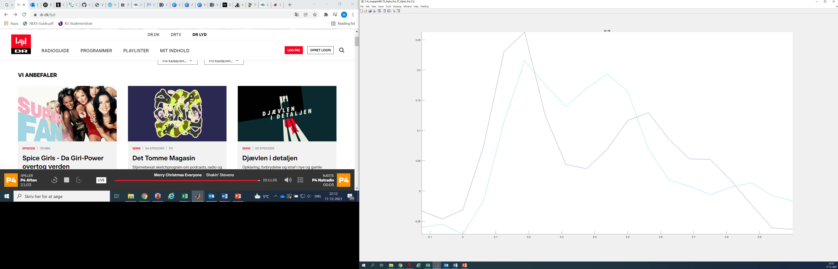
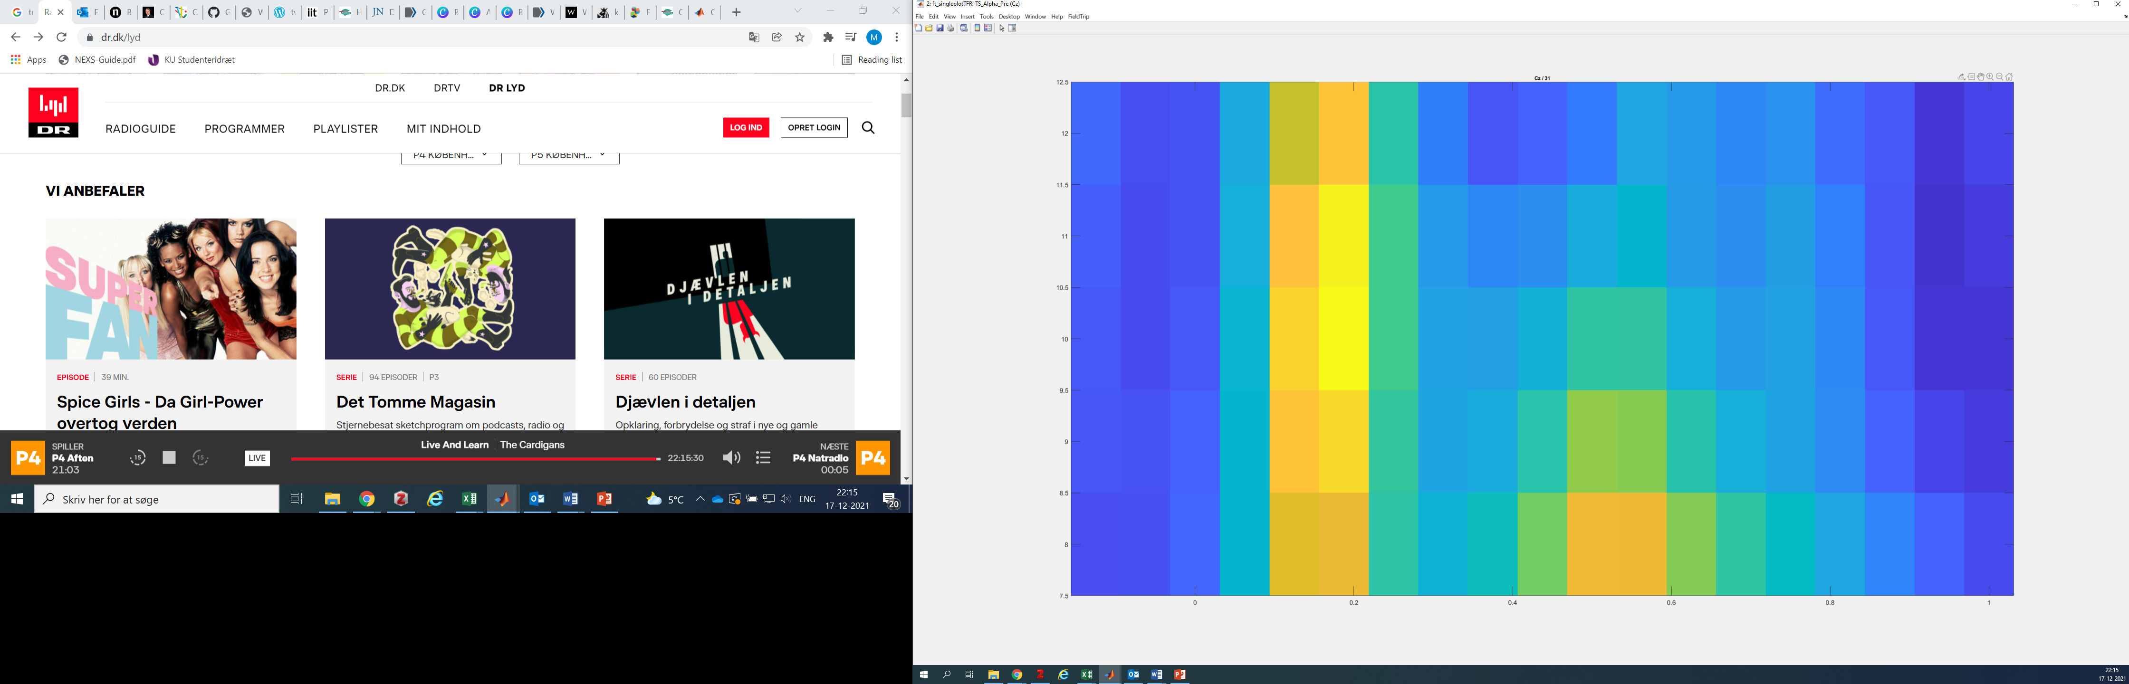
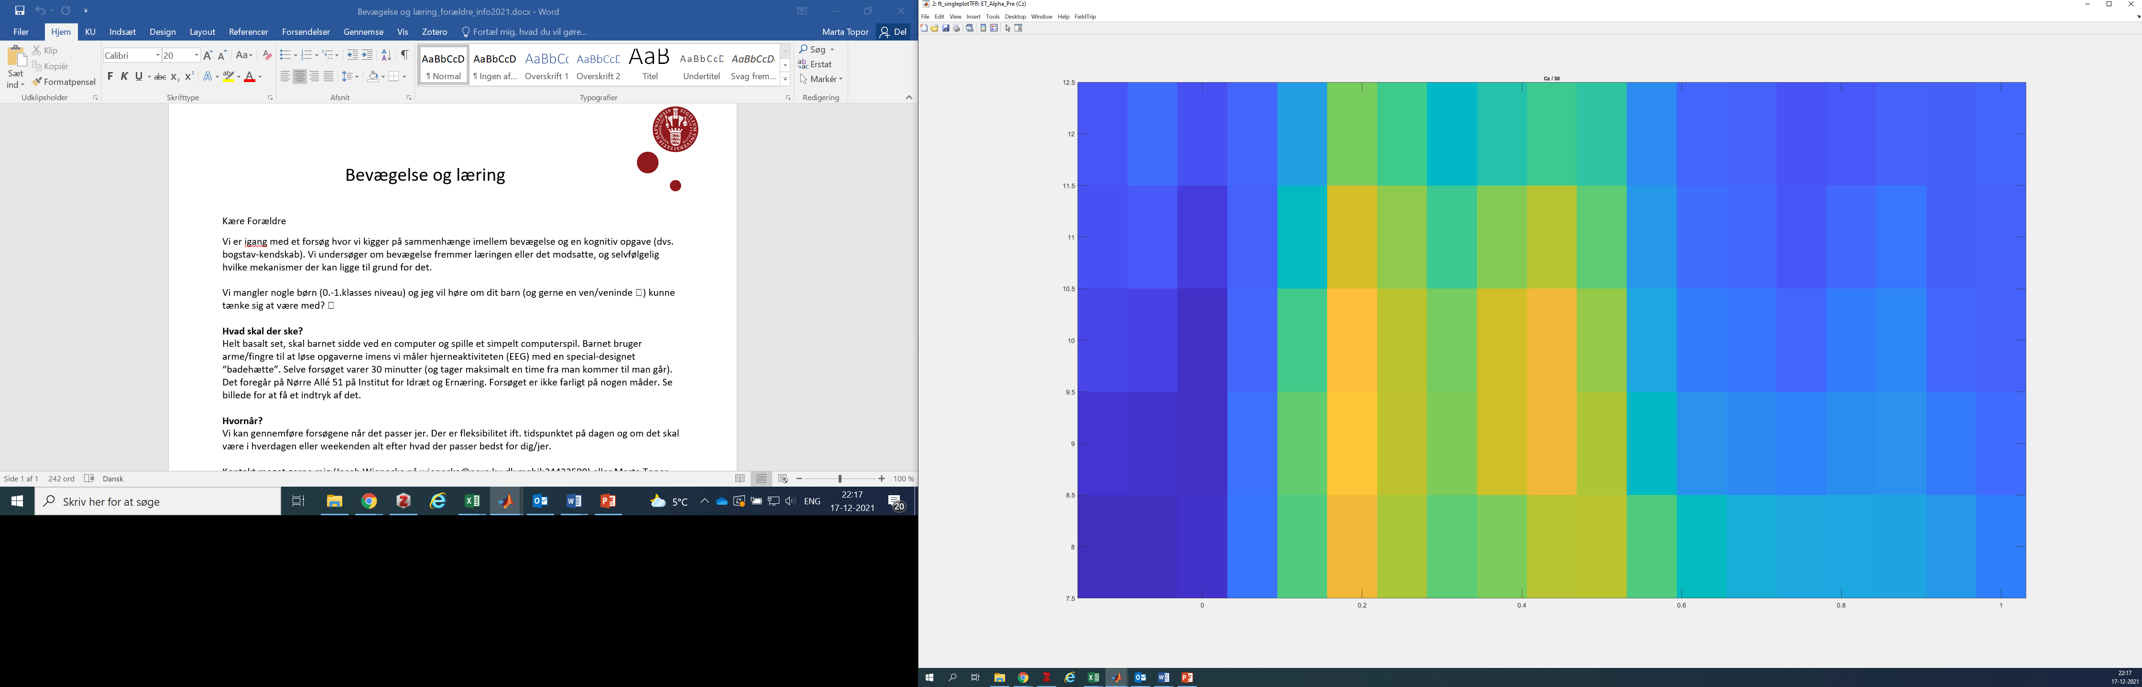
Alpha baseline (T0) by intervention
Cz
Touch Screen
Cz Alpha at 0-600ms is non-significant at p=.140
Touch Screen
Eye Tracker
18 Participants, Outliers removed, Divided by Intervention Group
Eye Tracker

Slide 8
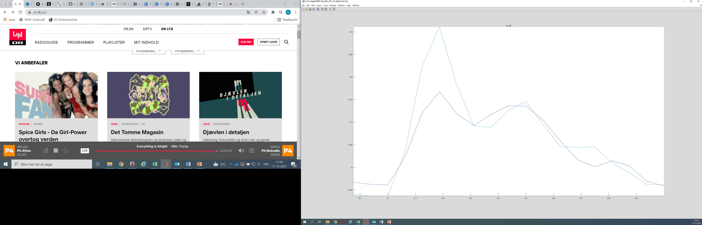
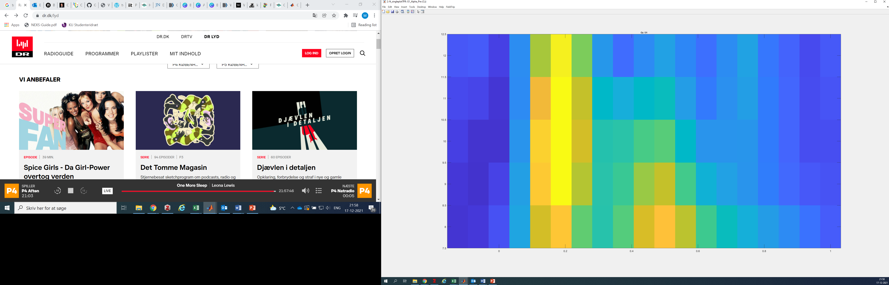
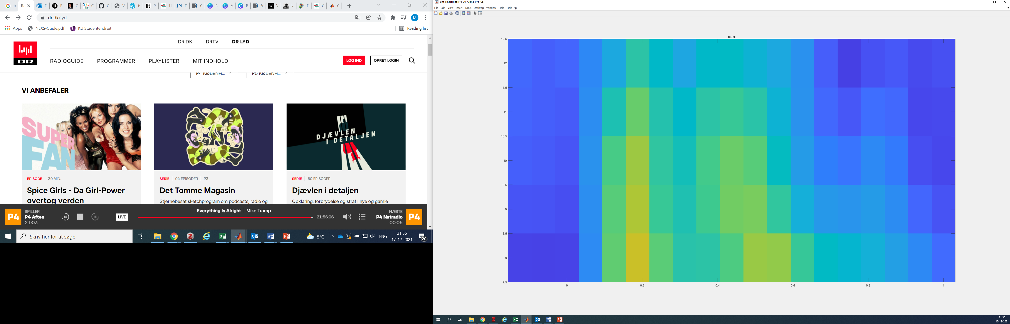
Alpha baseline (T0) by age
Cz
Grade 0
Cz Alpha at 0-600ms is non-significant at p=.151
Grade 1
Grade 1
Grade 0
18 Participants, Outliers removed, Divided by Age (9 in each group)

Slide 9

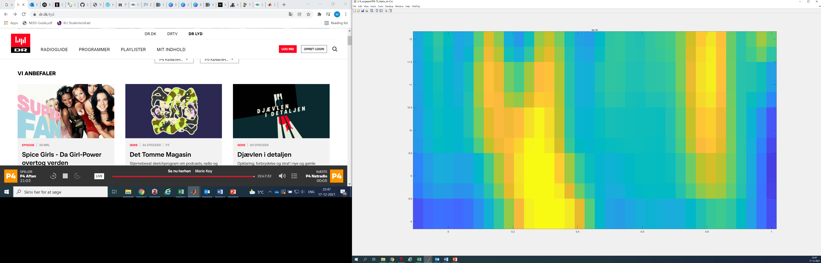
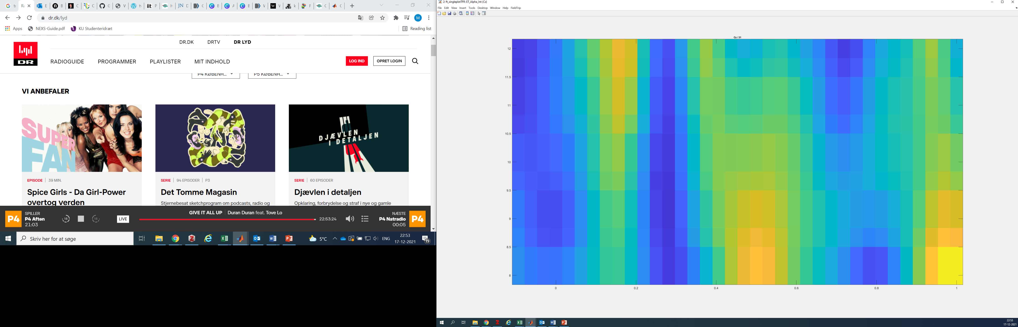
Alpha Intervention
Cz
Touch Screen
Cz Alpha at 0ms-600ms during Intervention non-significant p=.172
Eye Tracker
Touch Screen
Eye Tracker
18 Participants, Outliers removed, Divided by Age (9 in each group)
Notes:
- Upper alpha increases reflect additional attentional resources in language processing: https://doi.org/10.1016/j.bandl.2010.03.005
Differences between upper and lower alpha – ” The lower alpha changes are considered to reflect general task demands, such as attentional processes, while the upper alpha changes are suggested to reflect the task-specific processes such as stimulus encoding, semantic processing and memory access⁴². ” https://doi.org/10.1038/s41598-021-03321-9 - though they show desynchronisation of alpha rather than enhancement
Lower alpha enhacement found when performing multiplications – early categorisation and unspecific processing relating to task demands – attention (https://doi.org/10.1016/j.ijpsycho.2018.04.005)

Slide 10
Other analyses (pre and post)
- No clusters or significant differences for ERPs (P300 and P600) before and after the intervention, even with an exploratory analysis
- The same situation applies to alpha and theta
- No significant behavioural differences

Slide 11
Summary and further steps
- P300 is significantly larger during the motor intervention
- There is a strong early frontal theta activity during the motor intervention
- There is evidence of both early and late alpha activity during the motor intervention
Participants’ performance on the motor intervention is significantly higher than during the control
There are no significant differences between the groups before and after the intervention

